Slide 1
ERD Exercise

Slide 2
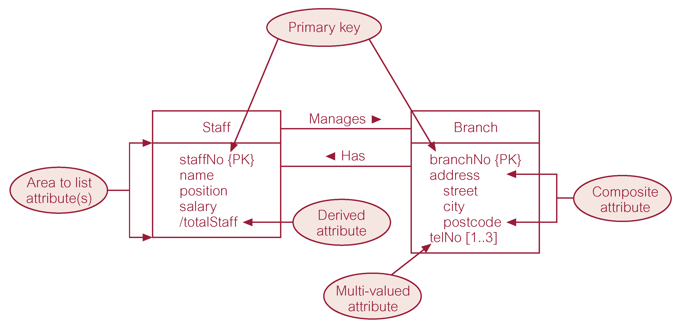
Creating an ERD from the Investigated Facts
Identify all the entities.
Identify all the relationships.
Identify cardinality and multiplicities (min max).
(1..*) (0..1) (0..*) (1..1)

Slide 3
Simple ERD 1
A painter can paint many paintings; each painting is painted by one painter. A gallery can have many paintings. A painting can be exhibited by a gallery.
Paint ►
(0..*)
Displayed
(1..1)
Painter
(1,1)
(0..*)
Painting
►
Gallery

Slide 4
Simple ERD 2
An employee can learn many skills; each sill can be learned by many employees.
Expert Level? (L1.. L5)
Learn ►
(0..*)
(0..*)
Employee
Skills
Expert Level

Slide 5
Simple ERD 3
An employee manages one store; each store is managed by one employee
Employee
Store
Manages ►
(0..1)
(1..1)
Employee
Store

Slide 6
Simple ERD 4
A College example
Students in a typical college or university will discover that each course can have many sections or no section, by each section refers to only one course.
For example, an Accounting II course might have two sections: one offered on Monday, Wednesday, and Friday from 10:00 a.m. to 10:50 a.m., and one offered on Thursday from 6:00 p.m. to 8:40 p.m.

Slide 7
Has ►
(1..1)
(0..*)
Course
Section

Slide 8
Simple ERD 5
Each student can take many classes (or no class at all) and each class can contain many students.
Add Grade
Take ►
Student
(1..*)
(0..*)
Classes
Grade

Slide 9
Combining ERDs
A class can be identified with course and section.
Has ►
(1..1)
(0..*)
Course
Section
Take ►
Student
(1..*)
(0..*)
Section

Slide 10
Has ►
(1..1)
(0..*)
Course
Section
(0..*)
Take▼
(1..*)
Student

Slide 11
Adding Additional Conditions
Adding prerequisite, enroll grade
Has ►
(1..1)
(0..*)
Course
Section
(0..*)
(0..*)
(0..*)
Take ▼
Grade
◄Prerequisite
(1..*)
Student

Slide 12
Case Study (Pine Valley Furniture Company )
1. The company sells a number of different furniture products.
These products are grouped into several product lines.
The identifier for a product is Product_ID, while the identifier for a product line is Product_Line_ID.
Referring to the customer invoice, we identify the following additional attributes for product: Product_Description, Product_Finish, and Unit_Price.
Another attribute fro product line is Product_Line_Name.
A product line may group any number of products, but must group at least one product.
Each product must belong to exactly one product line.

Slide 13
Case Study
2. Customers submit orders for products The identifier fro an order is Order-ID, and another attribute is Order_Date.
A customer may submit any number of orders, but need not submit any orders.
Each order is submitted by exactly one customer.
The identifier for a customer is Customer_ID.
Other attributes include Customer_Name and Customer_Address.

Slide 14
Case Study
3. A given customer order must request at least one product.
Any product sold by Pine Valley Furniture may not be requested on any order, or may be requested on one or more orders.
An attribute associated with each order and product is Quantity, which is the number of units requested.

Slide 15
Case Study
4. Pine Valley Furniture has established sales territories for its customers.
Each customer does business in one or more of these sales territories.
The identifier for a sales territory is Territory_ID.
A sales territory may have any number of customers, or may not have any customers doing business.

Slide 16
Case Study
5. Pine Valley Furniture Company has several salespersons. The identifier for a salesperson is Salesperson_ID.
Other attributes include Salesperson_Name, Salesperson_Telephone, and Salesperson_Fax.
A salesperson serves exactly one sales territory.
Each sales territory is served by one or more salespersons.

Slide 17
Case Study
6. Each product is assembled from one or more raw materials.
The identifier for the raw material entity is Material_ID.
Other attributes include Unit_of_Measure and Unit_Price.
Each raw material may be assembled into one or more products.

Slide 18
Case Study
7. Raw materials are supplied by vendors.
The identifier for a vendor is Vendor_ID.
Other attributes include Vendor_Name and Vendor_Address.
Each raw material can be supplied by one or more vendors.
A vendor may supply any numver of raw materials, or may not supply any raw materials to Pine Valley Furniture.
An attribute of the relationship between vendor and raw material is Unit_Price

Slide 19
Case Study
8. Pine Valley Furniture has established a number of work centers.
The identifier for a work center is Work_Center_ID.
Another attribute is Location. Each product is produced in one or more work centers.
A work center may be used to produce any number of products, or may not be used to produce any products.

Slide 20
Case Study
9. The company has over 100 employees.
The identifier for employee is Employee_ID.
Other attributes are Employee_Name, EmployeeAddress, and Skill.
An employee may have more than one skill.
A skill can be mastered by many employees

Slide 21
Case Study
10. Each employee works in one or more work centers.
A work center must have at least one employee working in that center, but may have any number of employees.

Slide 22
Case Study
11. Each employee has exactly one supervisor.
An employee who is a supervisor may supervise any number of employees, but not all employees are supervisors.

Slide 23
